Slide 1
Digital Summit South Europe
Visioboard

Slide 2
Data sharing
Do you know how our Top Management gets data info on Sales and Stock Performance daily?
Notes:
SMS since Nevermind Nirvana, Excel+Access 29 worksheet per 70 lines per 28 columns

Slide 3
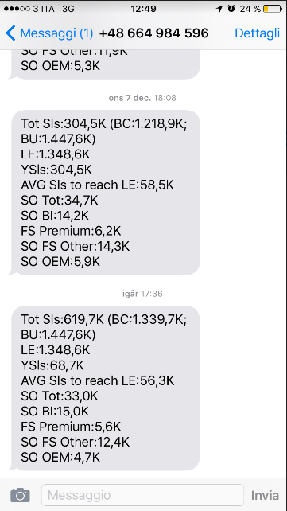
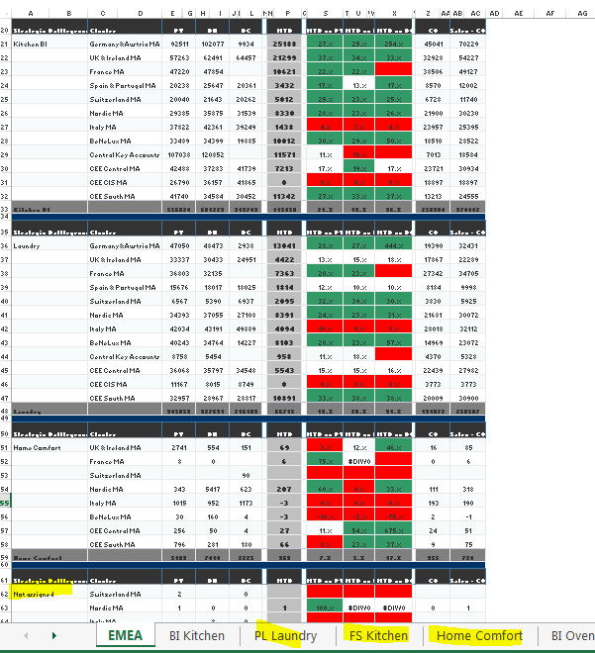



Yes, really.
Notes:
SMS since Nevermind Nirvana, Excel+Access 29 worksheet per 70 lines per 28 columns

Slide 4

Needs
Mobile and Visual
One set of data
Real time availability
Notes:
Everywhere, Shared, Fast

Slide 5
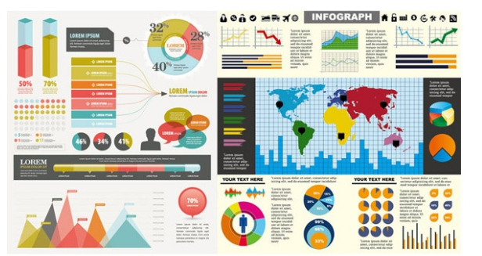

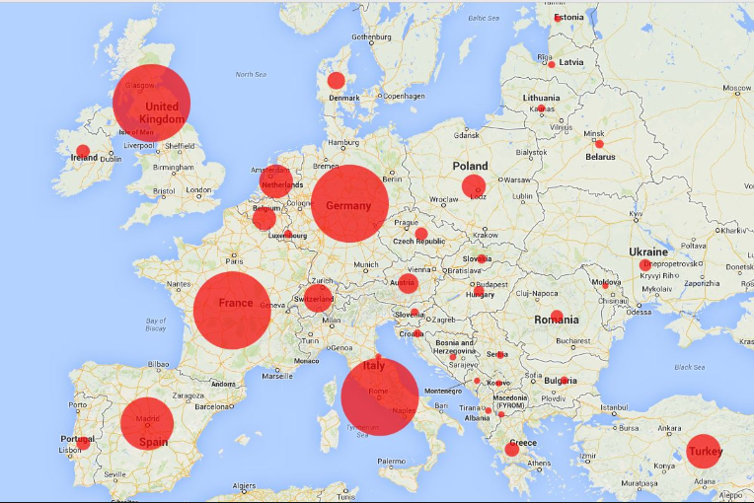
Tomorrow: Visioboard
Customizable Interactive Dashboard
E2E Shared data from CEO to Sales force
Intuitive Visualization
Cloud accessible
Notes:
Drill down at different level data availability, Highlight main deviations, User friendly, mobile, real time, connectivity

Slide 6
How we get there?
Big Data visualization tool
Mobile App
E2E Teamship approach
Notes:
Drill down at different level data availability, Highlight main deviations, User friendly, mobile, real time, connectivity

